Slide 1
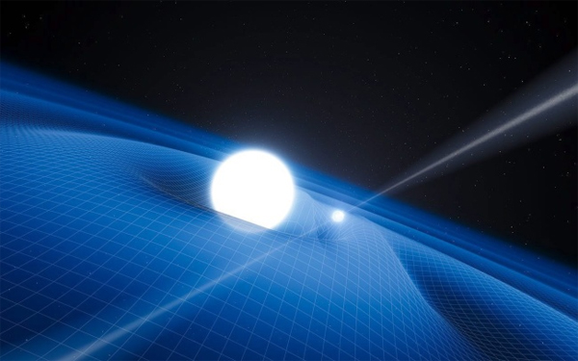

50th Aniversary of the Atomic definition of the SI second
J. Mauricio López R.
jm.lopez@cinvestav.mx
CINVESTAV
México

Slide 2
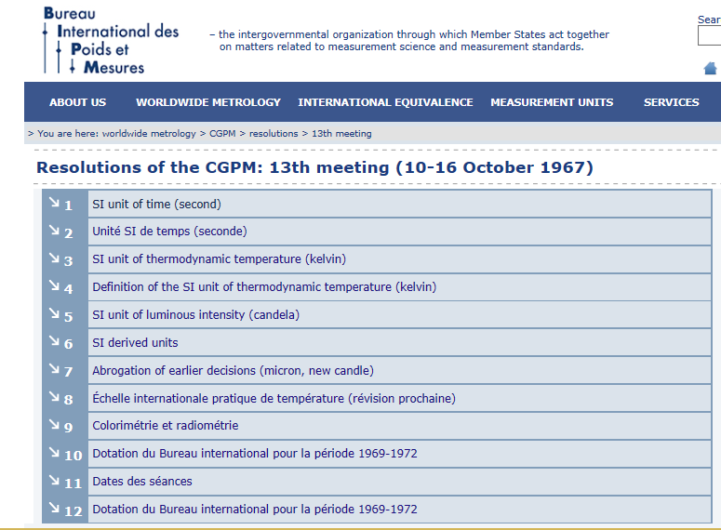

Resolutions of the CGPM: 13th meeting
(10-16 October 1967)

Slide 3
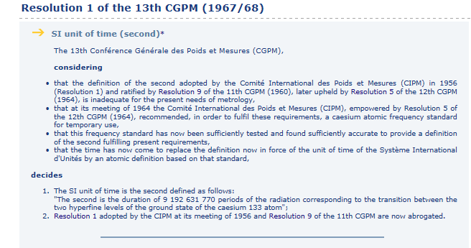
Resolutions of the CGPM: 13th meeting
(10-16 October 1967)

Slide 4
Cs-133 Quantum States
F’=5
11 sublevels
F’=4
251MHz
9 sublevels
6²P_{3/2}
F’=3
200MHz
7 sublevels
F’=2
150MHz
5 sublevels
≈100GHz
F’=4
9 sublevels
6²P_{1/2}
ENERGY
F’=3
1167MHz
7 sublevels
Not at scale
≈850nm
≈894nm
F’=4
9 sublevels
6²S_{1/2}
9.192631770 GHz
F’=3
7 sublevels
Coulomb
+
Spin-Orbit
+
Spin-Spin
+
Zeeman Effect
INTERACTION

Slide 5
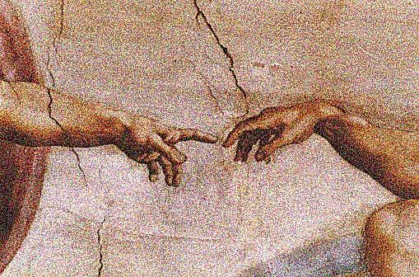
The conscience of time is probably the most important difference between human beings and animals

Slide 6
What is time?

Slide 7
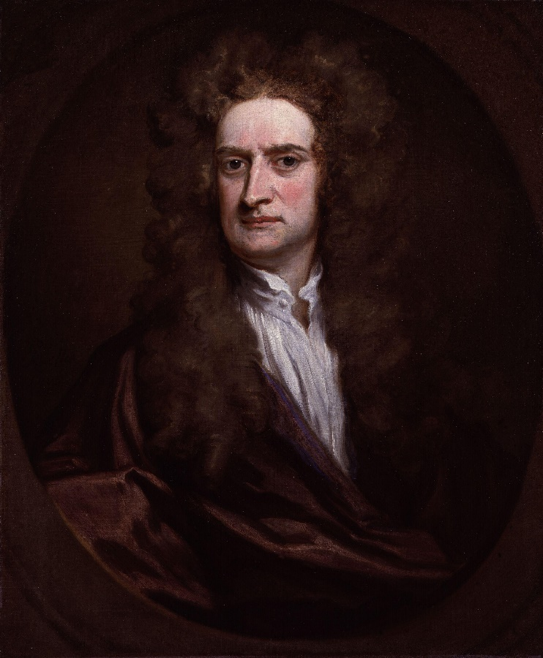
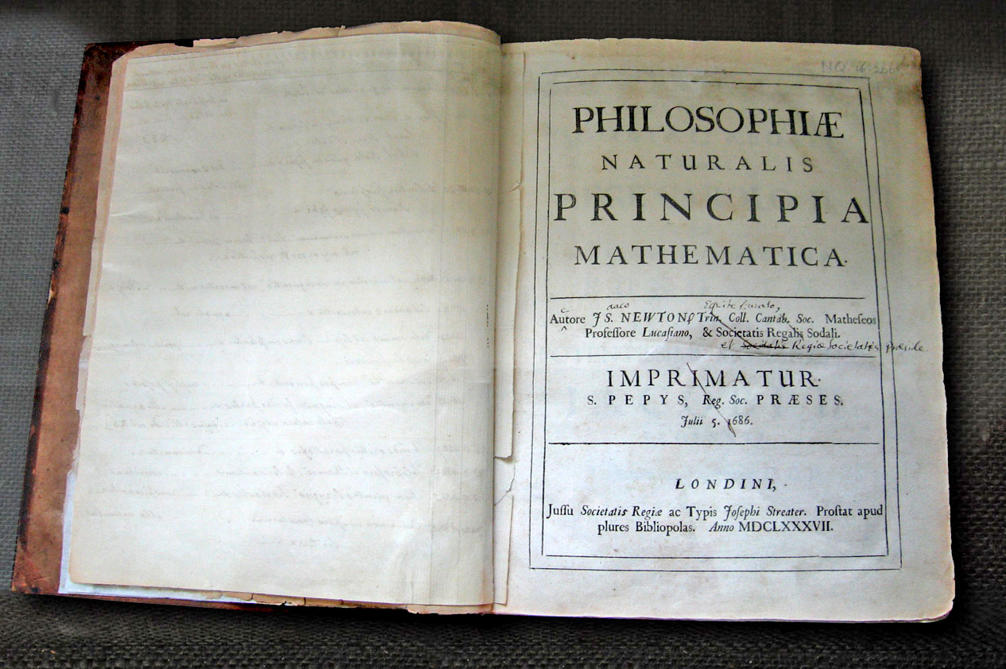
One step ahead towards the understanding of the time
Time is absolute

Slide 8
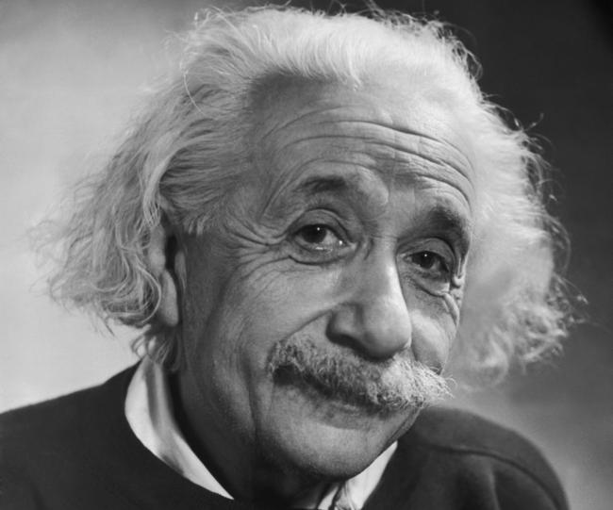
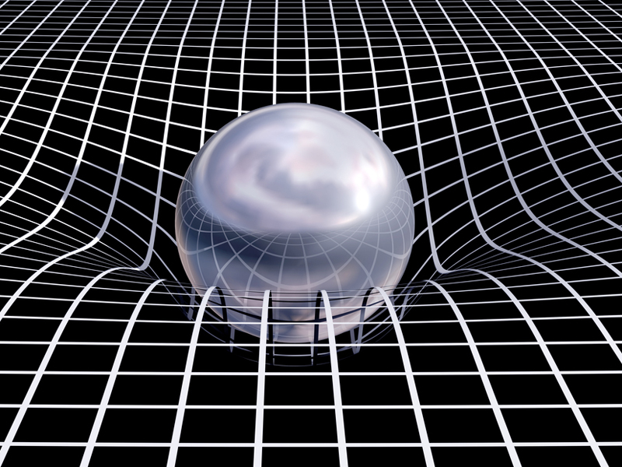
The Universe as a space of 4 dimensions
The space-time
Time is not absolute but relative

Slide 9
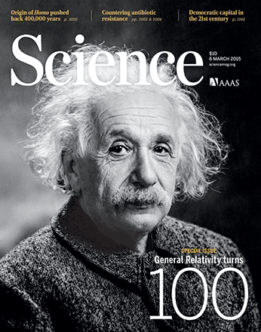
The Universe as a space of 4 dimensions
The space-time

Slide 10
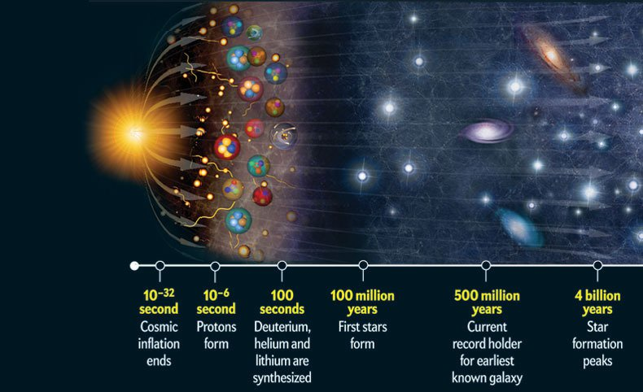
The history of the Universe (and time)

Slide 11
Time is what clocks measure
Albert Einstein

Slide 12
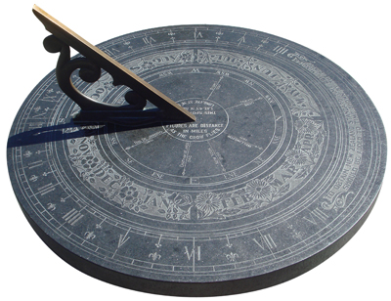

Slide 13
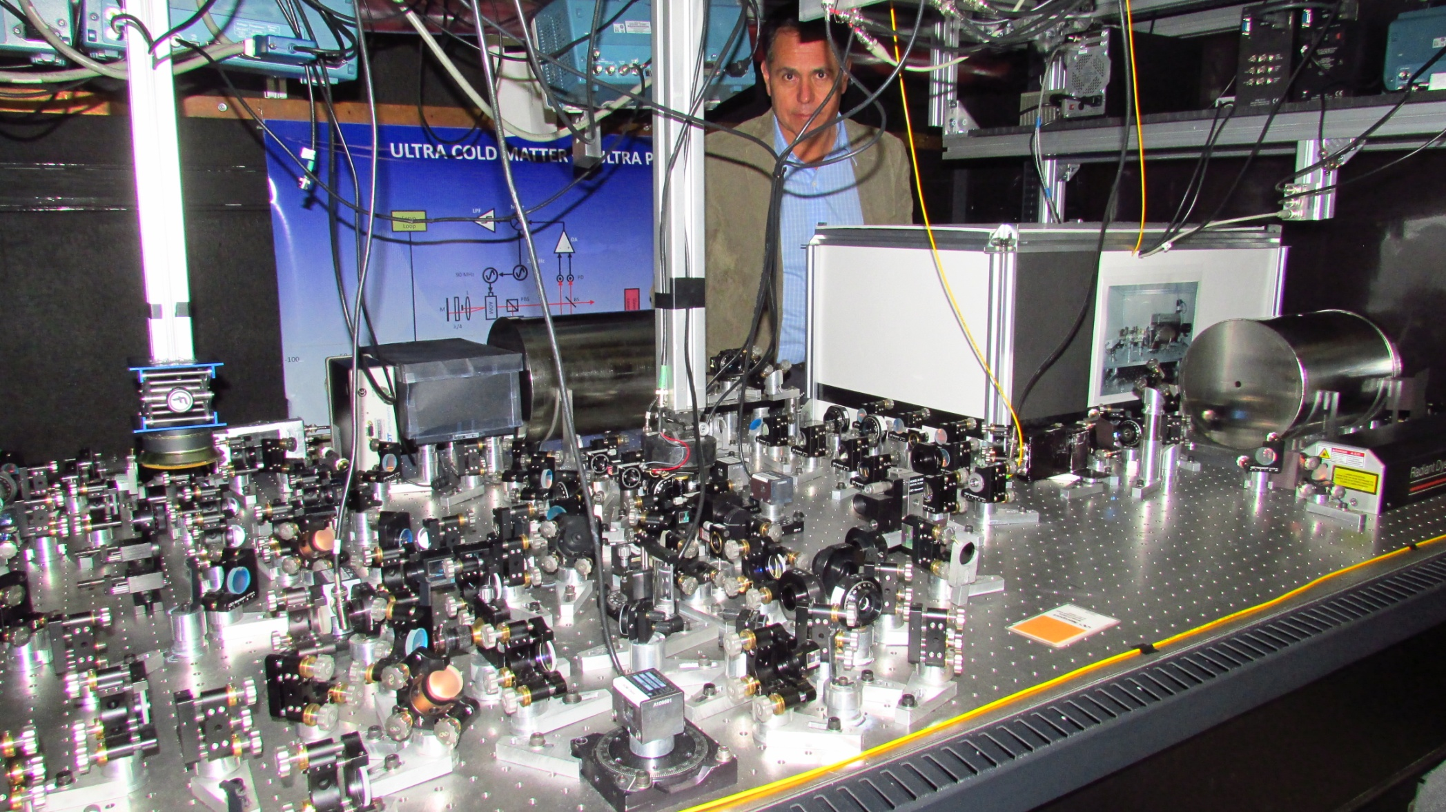
Atomic Clocks, Ultra Cold Matter, Quantum Criptography …

Slide 14
Clock = Oscillator + Counter

Slide 15
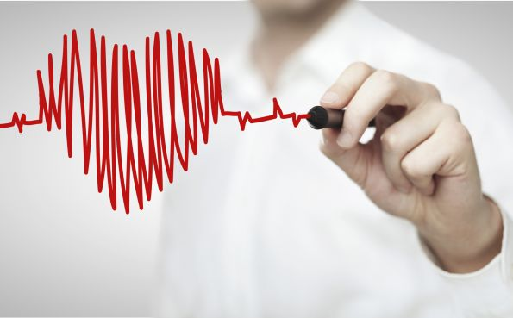
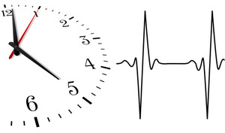
The heart as the closest clock of men
Clock = Oscillator + Counter

Slide 16
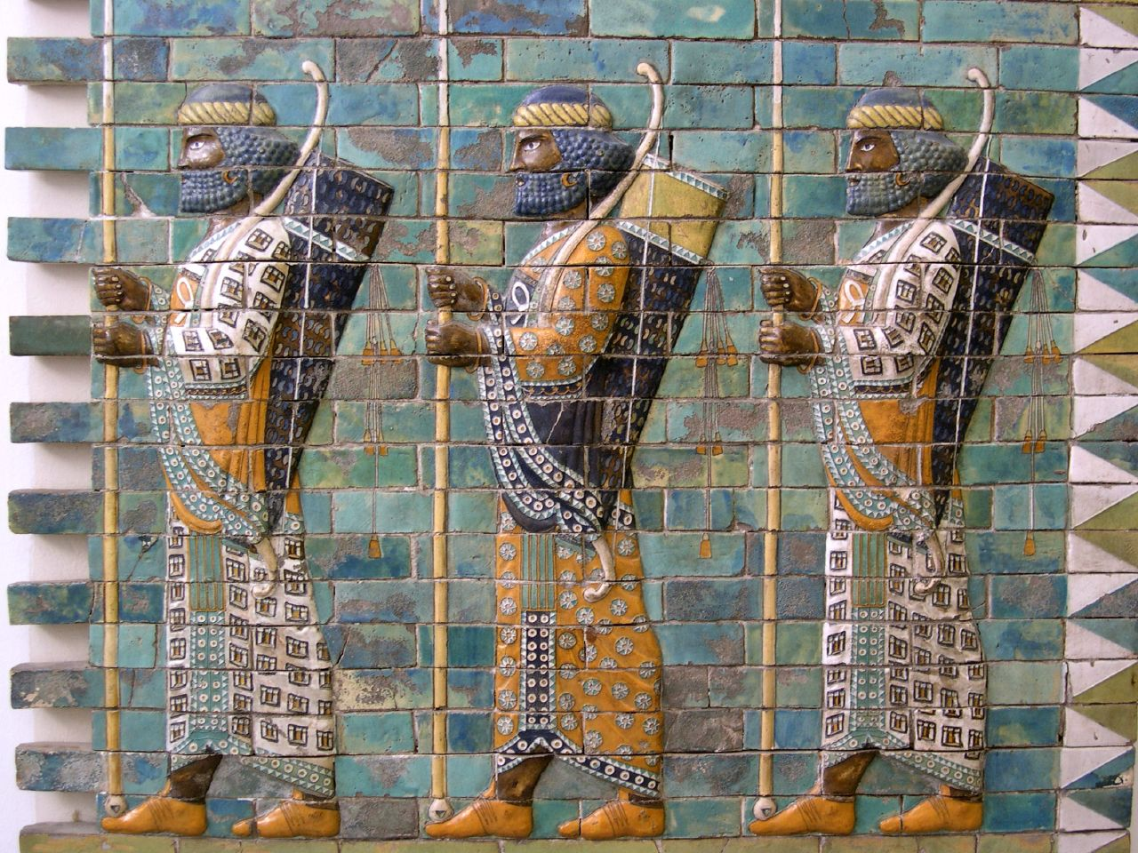
Time measurement is the oldest measurement of humankind
nearly 5000 years old

Slide 17
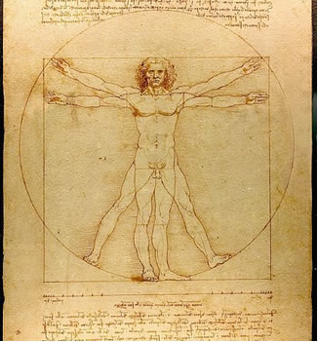
The second, the most anthropometric unit of measurement

Slide 18
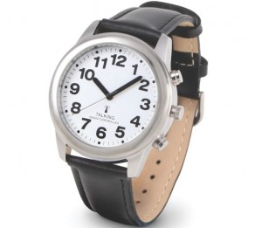
In clocks are resumed our civilization deepest past and our best science

Slide 19
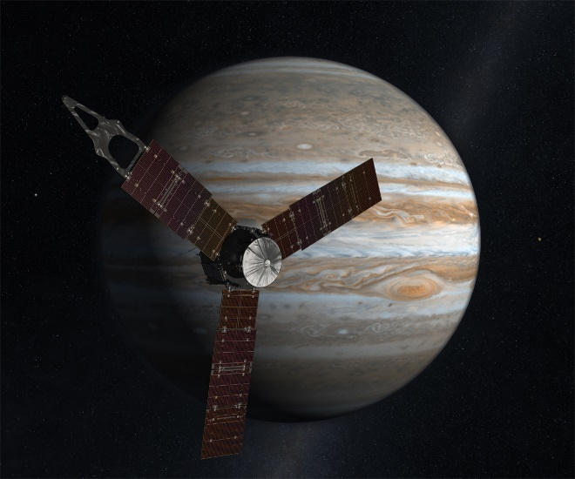
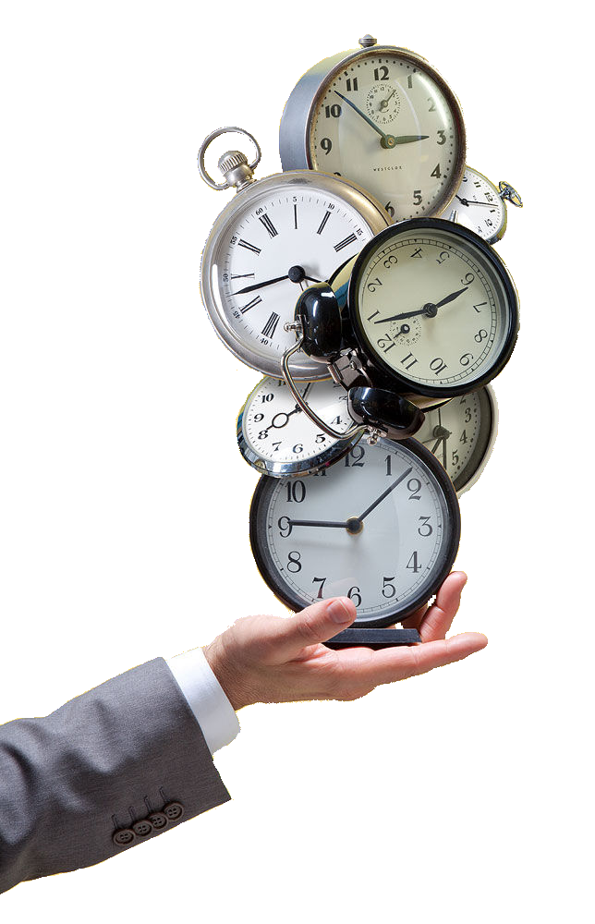
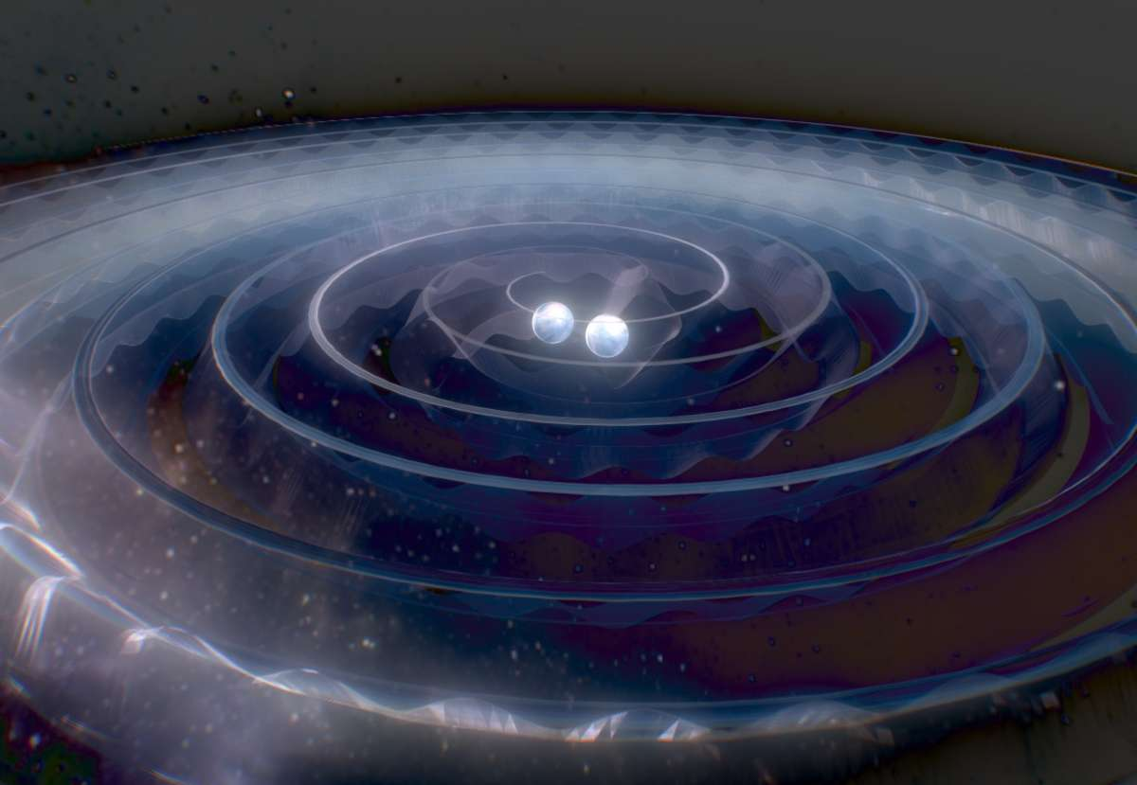
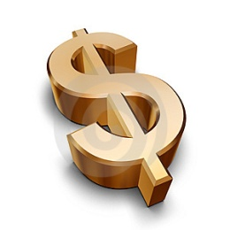
TWO FACES OF TIME MEASUREMENT
Scientific and fundamental research
Technological and practical applications
TIME
The most accurate measurement
TIME
The most measured physical quantity

Slide 20
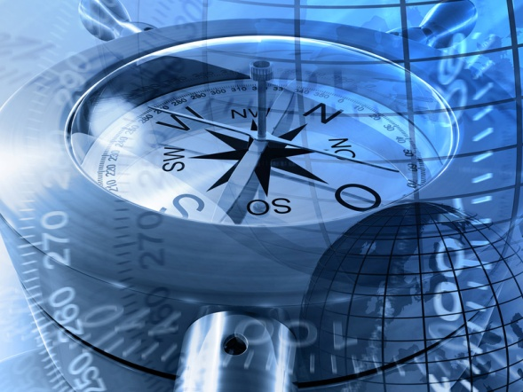

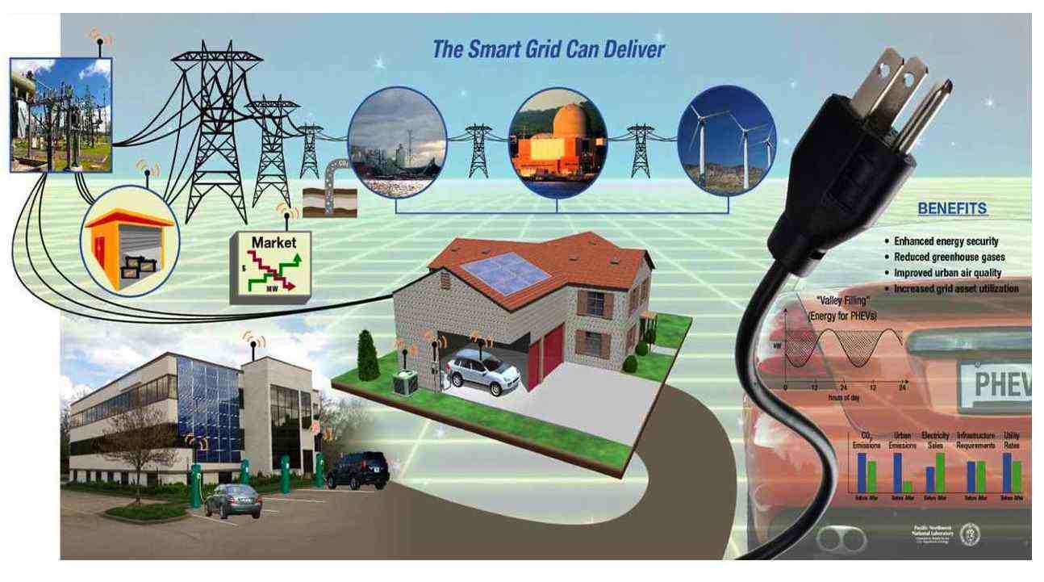
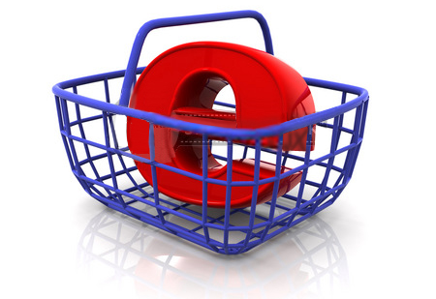
Time measurement is of great importance for science, technology and commerce. Among physical quantities, time appears as the most measured quantity worldwide and it stands for the highest accuracy measurement made by humankind.
Navigation
Communications
Commerce
Smart Grids

Slide 21
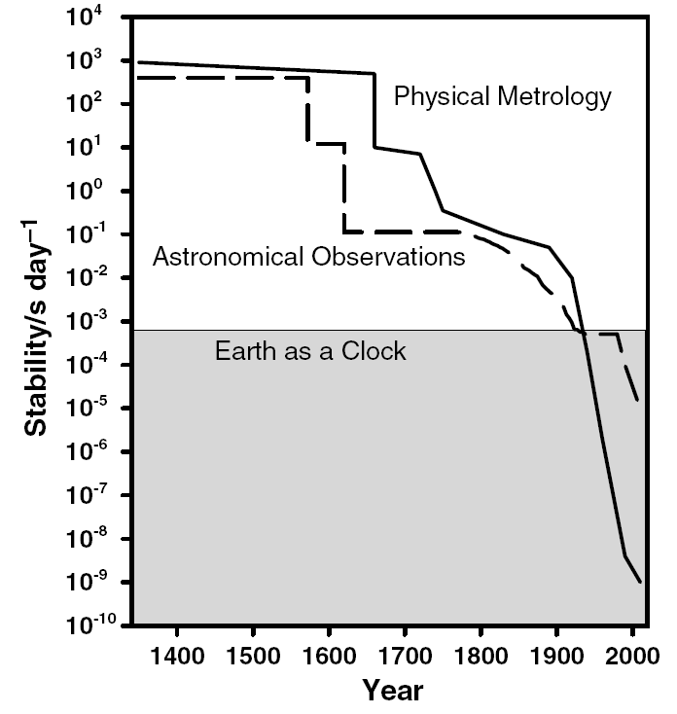
The last 600 years of time measurement
Dennis D. McCarty, Evolution of Time Scales from astronomy to physicasl metrology, Metrologia 48 (2011), S132 – S144.

Slide 22
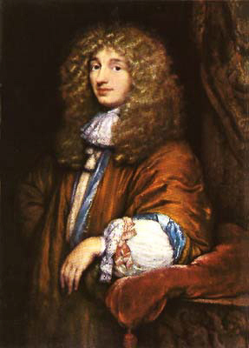
The last 600 years of time measurement
Accurate pendulum clock and the equation of time
Christiaan Huygens (1660)
Christiaan Huygens
(1629 – 1695)

Slide 23
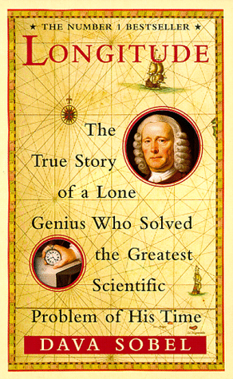
The last 600 years of time measurement
John Harrison chronometers
Longitude Act of 1714

Slide 24
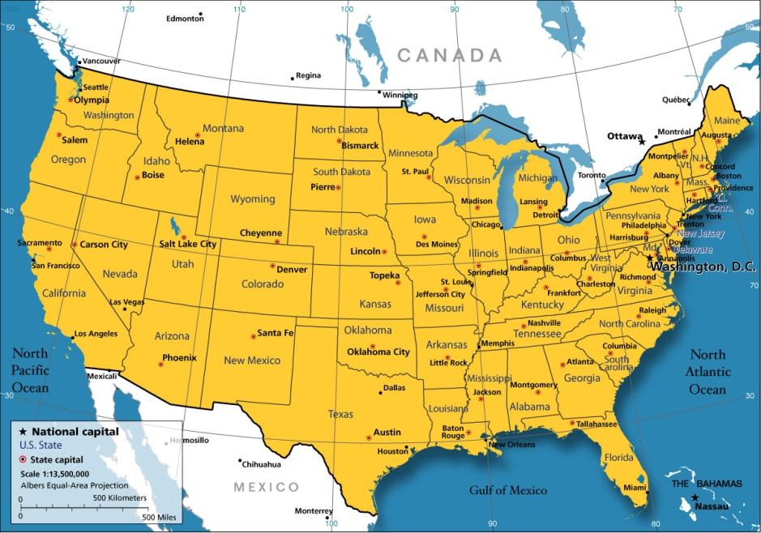
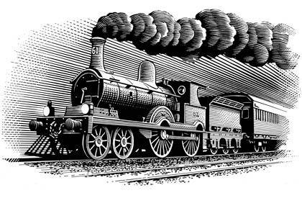
The last 600 years of time measurement
Greenwich meridian as interational reference (1884)

Slide 25
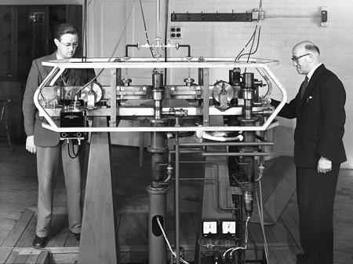
The last 600 years of time measurement
First atomic clock at NPL (1957)
Louis Essen and his NPL Cs atomic clock

Slide 26
The last 600 years of time measurement
The second is the duration of 9 192 631 770 periods of the radiation corresponding to the transition between the two hyperfine levels of the ground state of the Cesium 133 atom.
Atomic definition of the second, 1967
Resolution 1, 13th CGPM, 1967

Slide 27
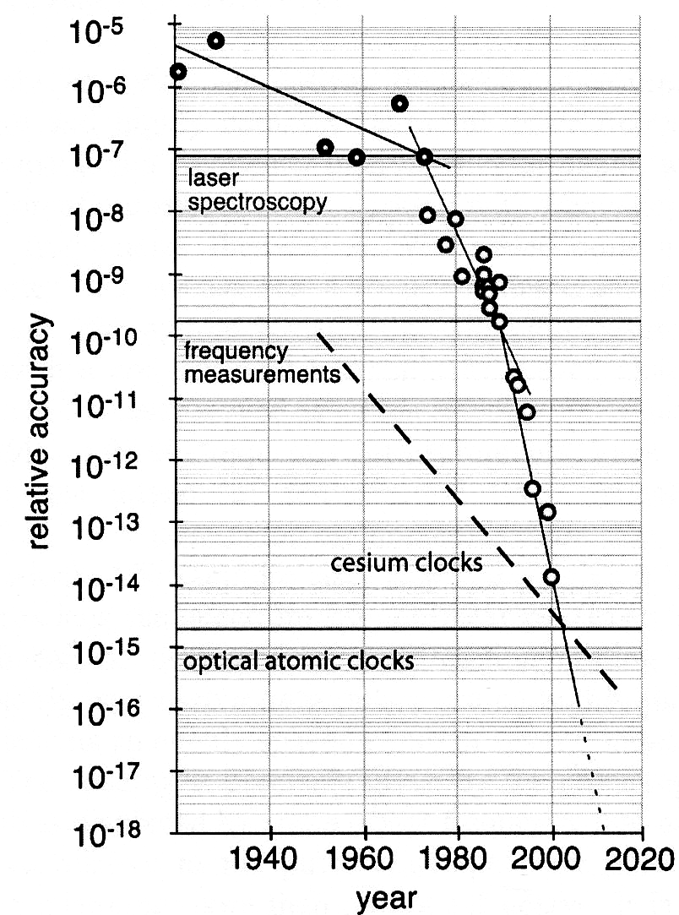
The last 600 years of time measurement
Progress at one order of magnitud per decade
Atomic clocks era

Slide 28
The last 600 years of time measurement
Progress at one order of magnitud per decade
Ultracold matter and Cs fountain clocks

Slide 29
The last 600 years of time measurement
Progress about four orders of magnitud per decade !!
Frequency combs and optical atomic clocks

Slide 30
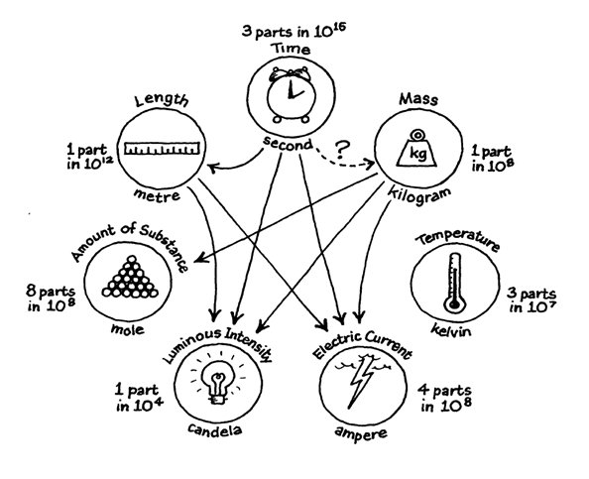
The base units of the International System of units

Slide 31
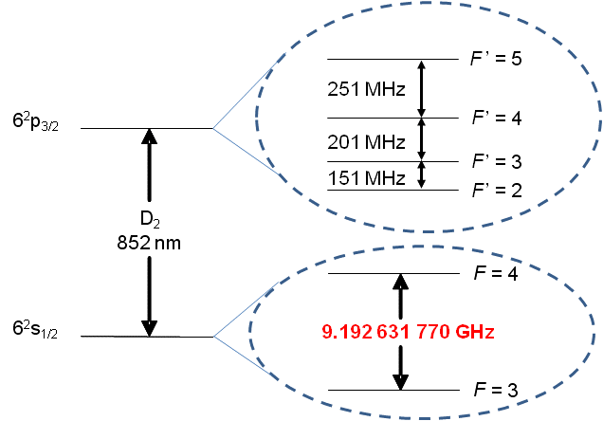
Cs-133 Atomic Clocks
The second is the duration of 9 192 631 770 periods of the radiation corresponding to the transition between the two hyperfine levels of the ground state of the Cesium 133 atom.
Hiperfine structure
Ground state

Slide 32
What is an atomic clock?

Slide 33
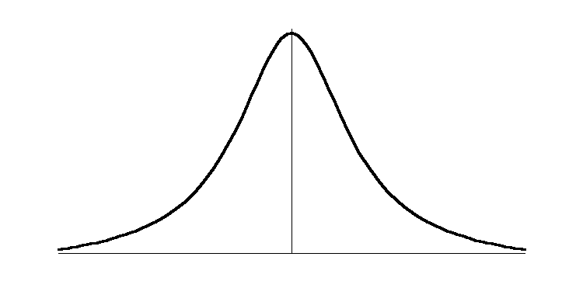
Disciplined oscillators
The basic concept of an atomic/optical clock
δν_{L}
δν_{L}
δν_{A}
ν_{L}
ν_{L}
ν
ν₀
ν_{L} ≈ ν₀

Slide 34
Frequency Stability of an Atomic Clock
Δν
ν_{o}
Allan Deviation

Slide 35
Strategies to develop better atomic clocks
Cold atoms and very long lifetime on excited states
Optical Frequencies
Large amount of atoms
Large averaging times / robust systems

Slide 36
Nuclear Magnetic Resonance and atomic clocks

Slide 37
Spin invertion by the action of a rotating magnetic field Rabi´s Method
z
Larmour Frequency
ω₀
φ
Constant magnetic field

Slide 38
Spin invertion by the action of a rotating magnetic field Rabi´s Method
z
Larmour Frequency
ω₀
ω
φ
Constant magnetic field
Rotating magnetic field perpendicular to H₀

Slide 39
Spin invertion by the action of a pulsed rotating magnetic field Ramsey´s Method
z
Larmour Frequency
ω₀
ω
φ
Constant magnetic field
Rotating magnetic field perpendicular to H₀
Pulsed!

Slide 40
Ramsey Method
Generador de
Microondas
Lazo de
amarre
Vacío
Cavidad de Ramsey
Campo Magnético Inhomogéneo (Campo A)
Campo Magnético Inhomogéneo (Campo B)
Contenedor con Cesio 133
Filamento
Incandescente (Ionizador)
Detector
CampoMagnético Constante
(Campo C)

Slide 41
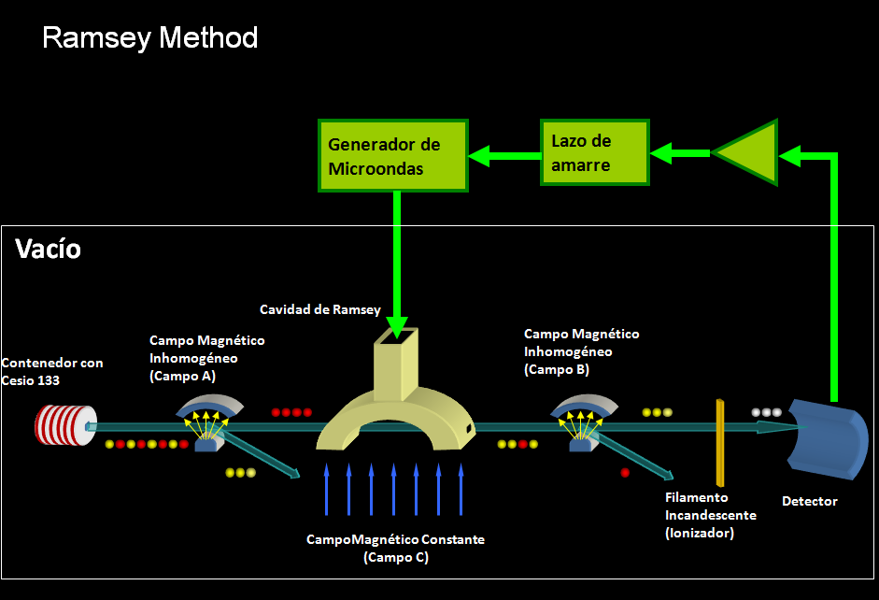
First atomic clocks (1957)

Slide 42
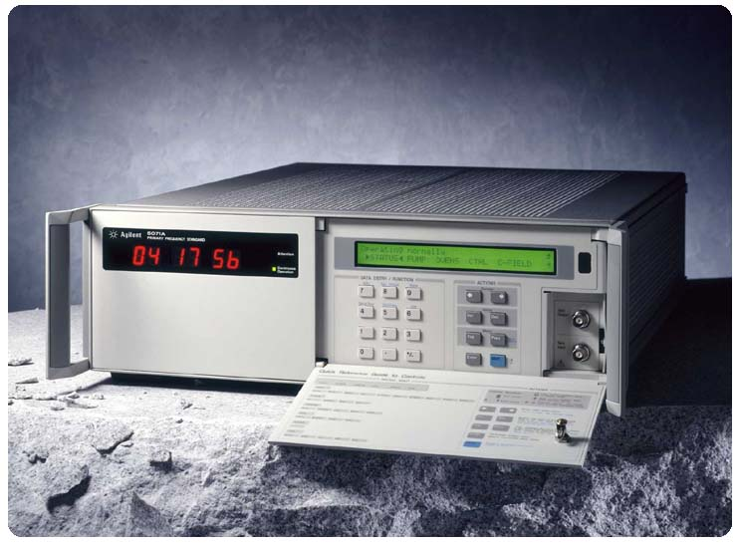

Commercial available Cs atomic clock using the magnetic selection of N. Ramsey

Slide 43
Cs-133 Optical pumping
F’=5
11 sublevels
F’=4
251MHz
9 sublevels
6²P_{3/2}
F’=3
200MHz
7 sublevels
F’=2
150MHz
5 sublevels
≈100GHz
F’=4
9 sublevels
6²P_{1/2}
ENERGY
F’=3
1167MHz
7 sublevels
Not at scale
≈850nm
≈894nm
F’=4
9 sublevels
6²S_{1/2}
9.192631770 GHz
F’=3
7 sublevels
Coulomb
+
Spin-Orbit
+
Spin-Spin
+
Zeeman Effect
INTERACTION

Slide 44
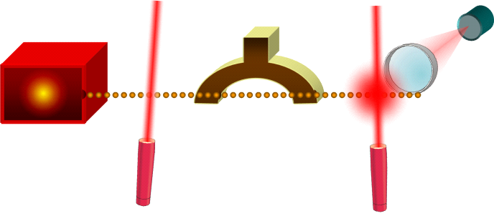
Ramsey method with optical pumping (1985)
Microwave
Oscillator
Phase lock
loop
Detector
Ramsey Cavity
Cs Oven
Pumping Laser
Detection Laser

Slide 45
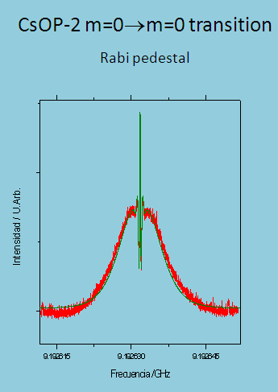
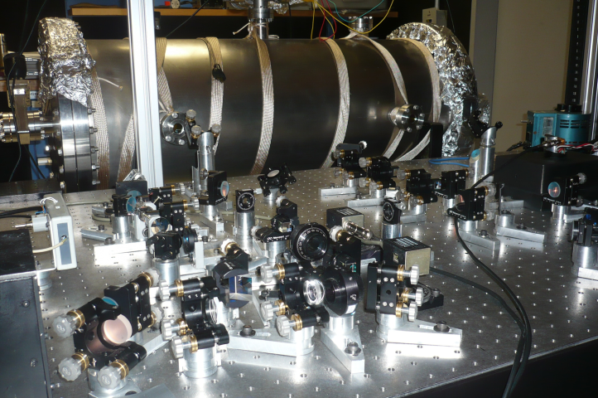
Optically pumped thermal Cs beam clock CENAM CsOp-2
180 Hz

Slide 46
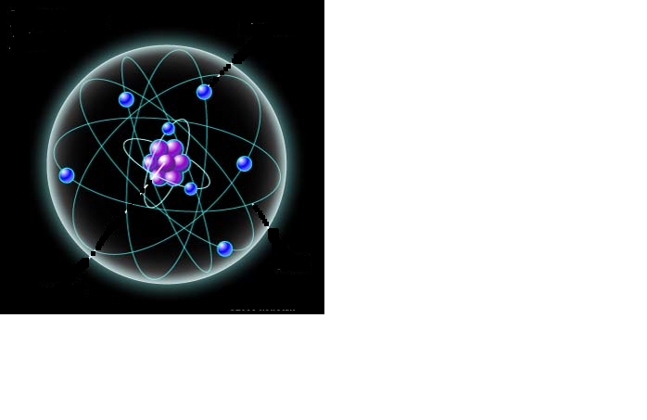
Doppler Cooling
A two quantum states model
E₂
Energy
E₁
Laboratory reference frame
v
ν_{F}=ν₀-ε
ν_{F}=ν₀-ε
ν₀

Slide 47
Doppler Cooling
A two quantum states model
Atom´s reference frame
ν_{L}= ν_{F} - k·v + …<< ν₀
ν_{R} = ν_{F} + k·v + … ≈ ν₀
ν₀

Slide 48
Doppler Cooling
A two quantum states model
Doppler limit
Cesium-133
Sodium
h ≈ 6,6×10⁻³⁴ J⋅s
k_{B} ≈ 1,3×10⁻²³ J/K

Slide 49
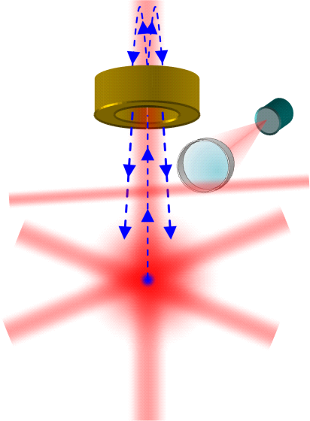
Cs Fountain Clock
(1990)
Wayne M. Itano, Norman F. Ramsey, Accurate Measurement of Time, Scientific American, July 1993.
Microwaves cavity
Detector
Detection laser
Optical molases
Cooling beams

Slide 50
Clock transition
Wayne M. Itano, Norman F. Ramsey, Accurate Measurement of Time, Scientific American, 1993.
Resolution of the peak

Slide 52
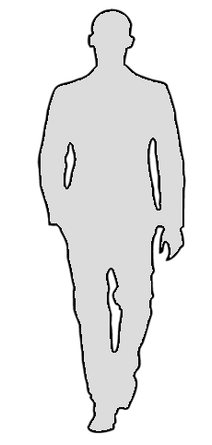
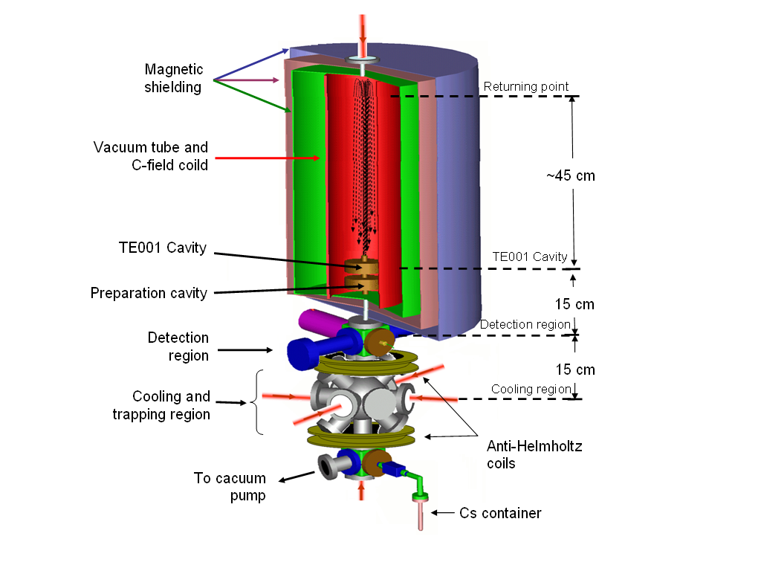
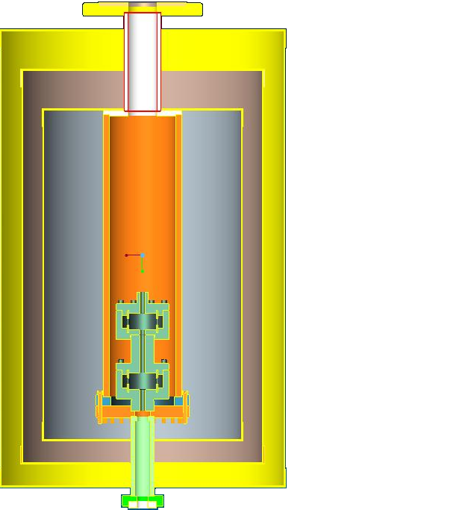
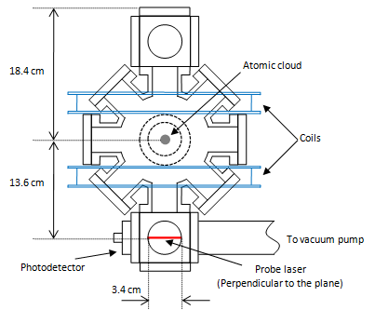
CENAM CsF-1
physical package
35.0 cm
22.0 cm
33.0 cm

Slide 53
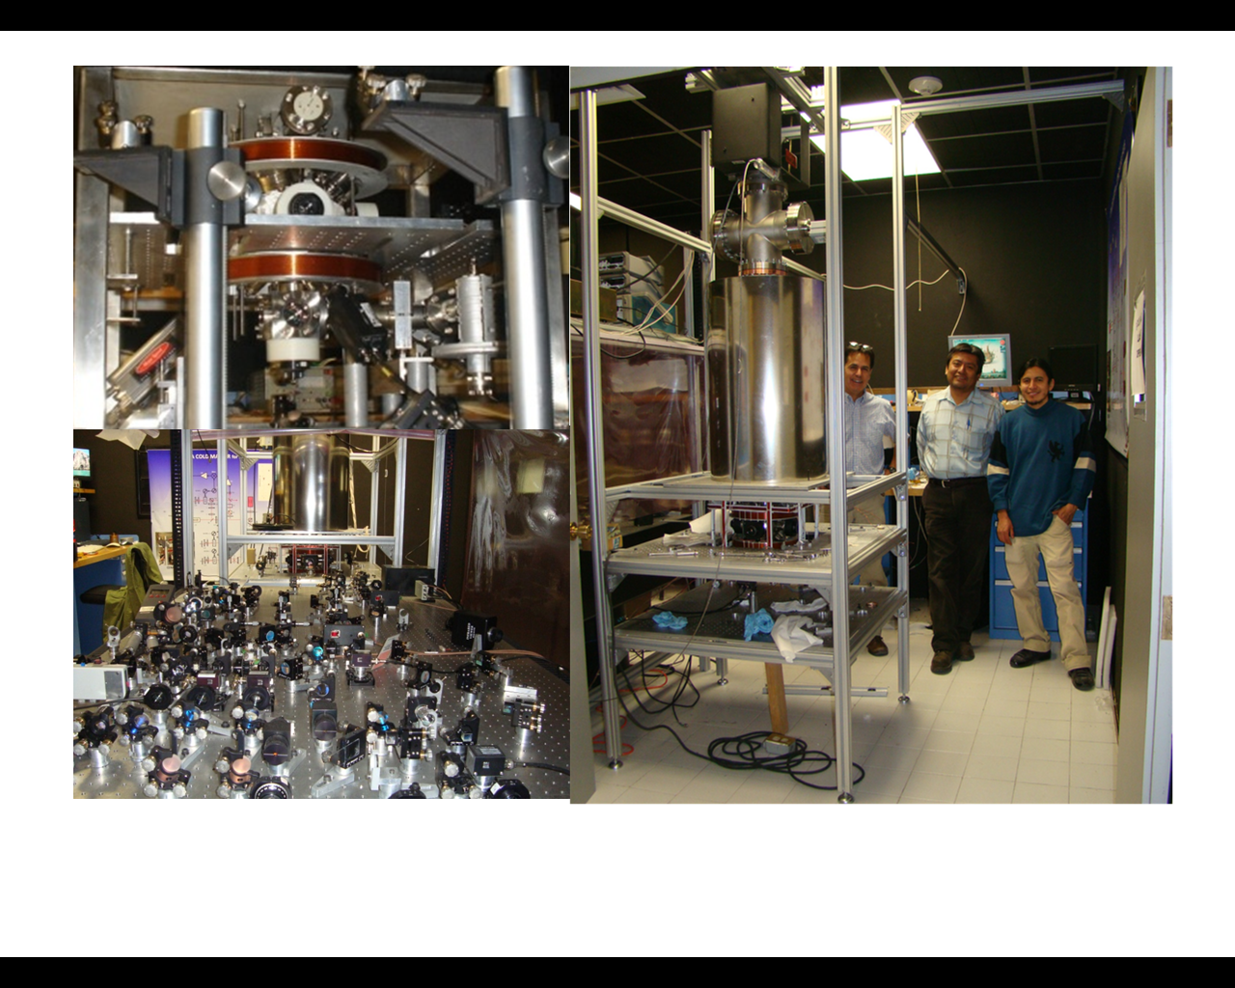
Cesium fountain clock
CENAM CsF-1
MOT
Optical system
Physics package

Slide 54
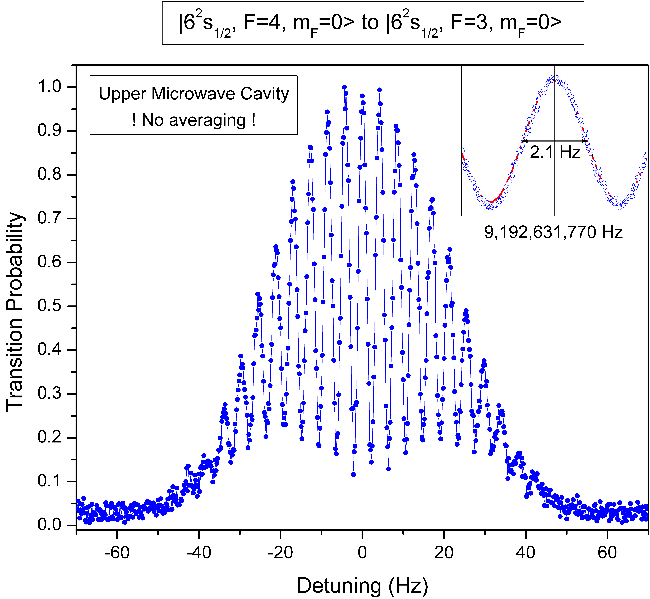
Clock Transition - Ramsey Signal

Slide 55

Computation of TAI and UTC
≈ 350 atomic clocks
in ≈ 70 laboratories
“average”
Echelle
Atomique
Libre
EAL
≈ 10 primary frequency
standards (≈ 5 labs)
“steering”
Temps
Atomique
International
TAI
Measurement of Earth’s rotation (IERS)
“leap seconds”
Temps
Universel
Coordonné
UTC(k)
Circular T
UTC
Role of the BIPM

Slide 56
Timing laboratories around the world
Red de comparaciones del BIPM para la generación del UTC
NORTH AMERICA
EUROPE
ASIA
CRL
NRC
USNO
NPL
DTAG
USNO
PTB
SMU
CRL
IFAG
KRIS
NIST
CH
NTSC
SCL
NMC
TL
CNM
UME
NIMT
NMLS
ROA
VSL
NIMB
CAO
OMH
SG
IEN
IPQ
TCC
ONRJ
MSL
IGMA
CSIR
AUS
ONBA
SOUTH AMERICA
AFRICA
OCEANIA

Slide 57
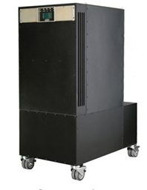
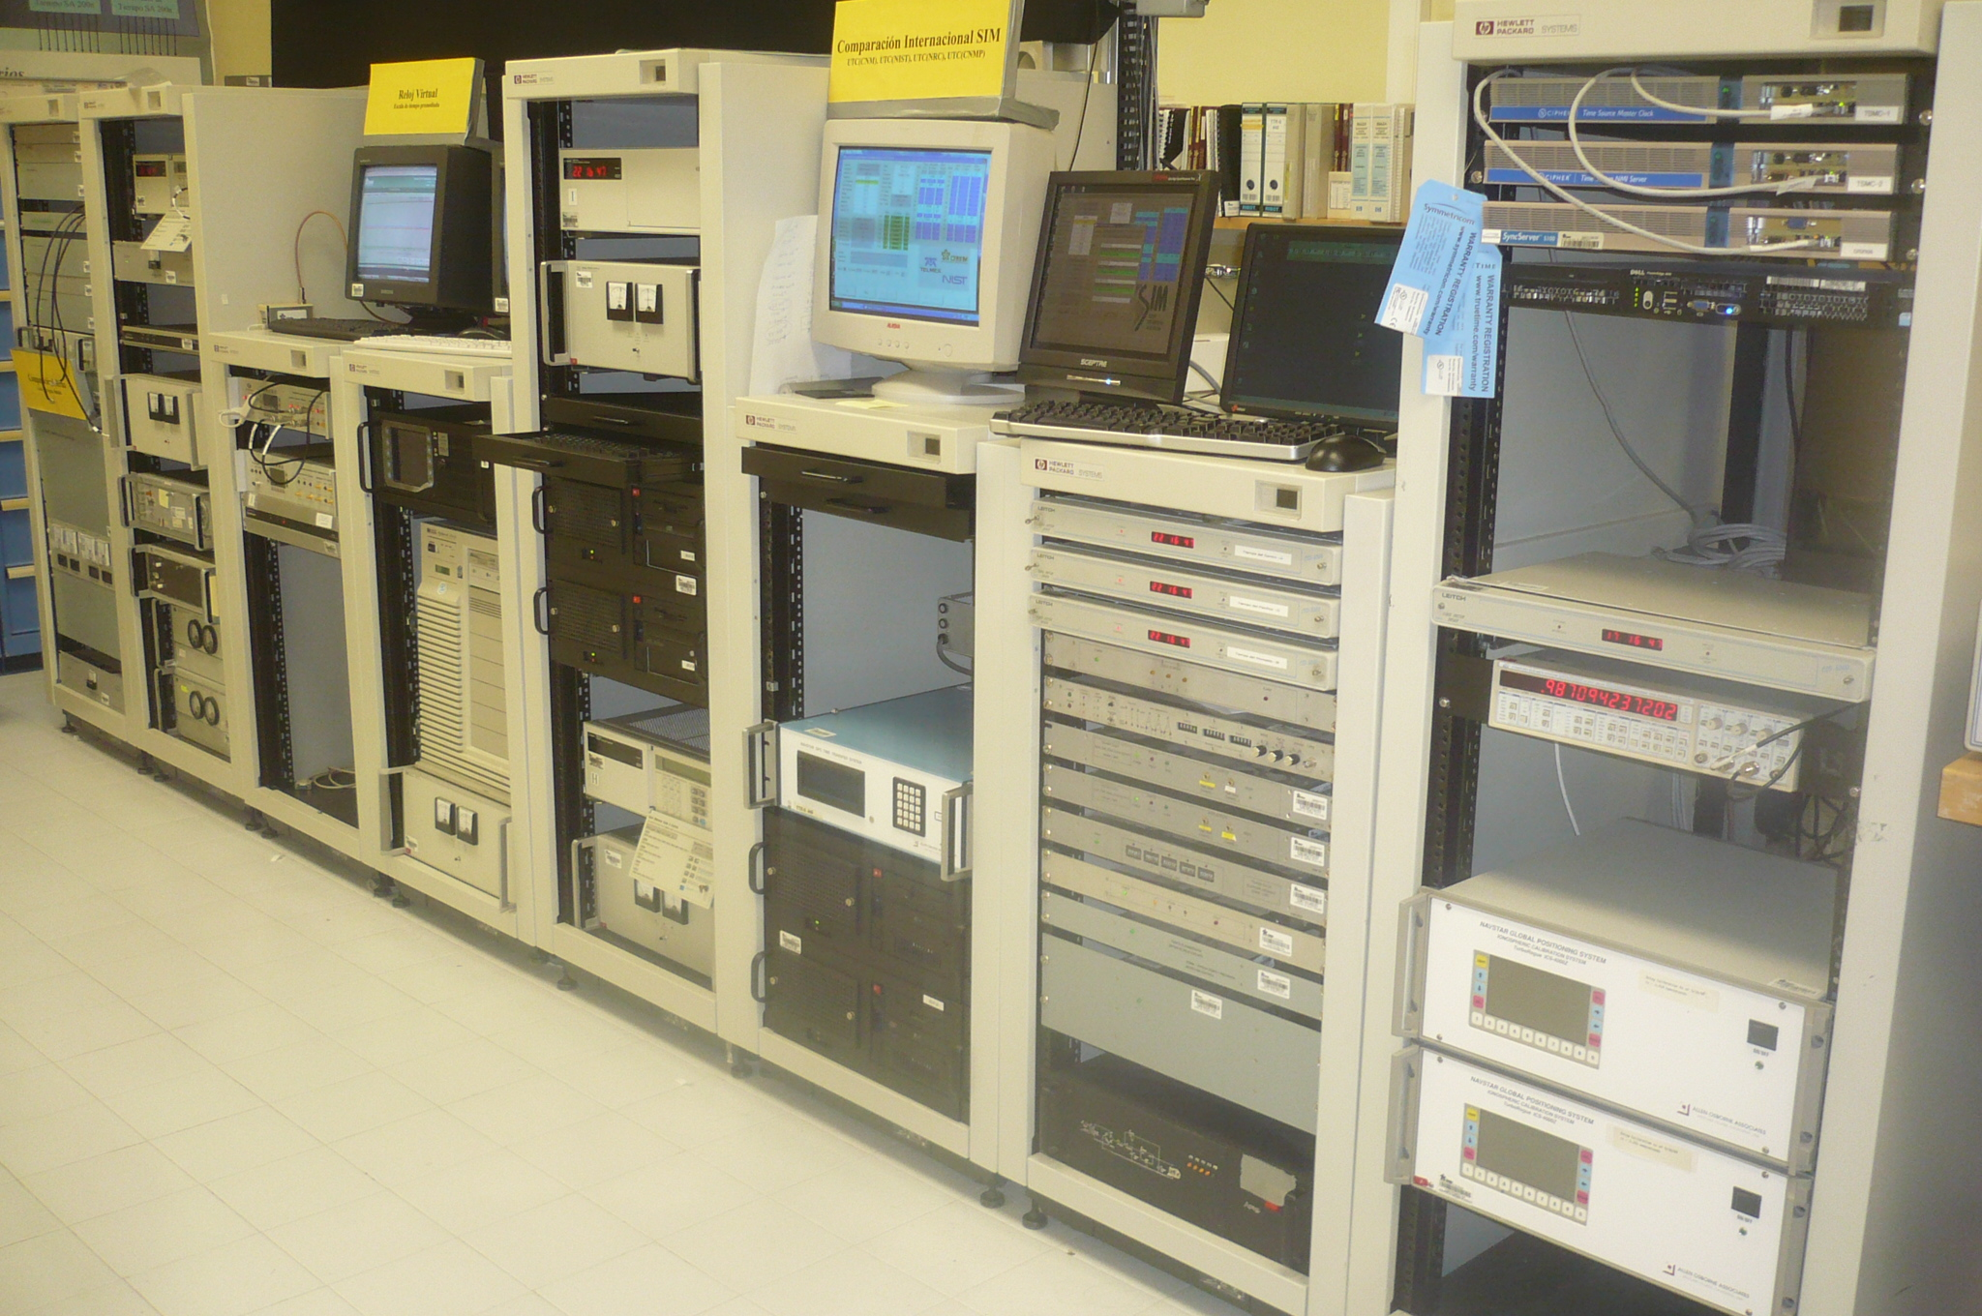
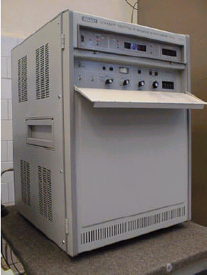


Typical equipment for a timekeeping laboratory
(CENAM example)
Ensemble of Cs commercial clocks

Slide 58

Timekeeping in the Americas
SIM
BIPM
SLBS
USNO
INM
NRC
ICE
NIST
NRL
SNM
APL
BSJ
CENAM
INN
TTBS
CENAMEP
INXE
ABBS
ONBA
ONRJ
CMEE
IGMA
INTI
TCC
INTN
LNM
UTE
Sistema Interamericano de Metrología
Bureau International des Poids et Mesures

Slide 59

Timekeeping laboratories in the Sistema Interamericano de Metrología (SIM) Time Network

Slide 60



A NEW ALGORITHM FOR CLOCK WEIGHTS
FOR THE SIM TIME SCALE
Clock A
GPS satellite
Measuring system A
GPS –Clock A
Measuring system B
GPS – clock B
Clock B
Time of the day
Time of the day

Slide 61
Optical spectroscopy and a new definition of the SI second

Slide 62
Key elements for a new definition of the SI second
1. Ultra stable lasers
2. Frequency combs
3. Ultra narrow Optical transitions in ions or neutral atoms
4. Optical time scales

Slide 63
Key elements for a new definition of the SI second
✓
1. Ultra stable lasers
✓
2. Frequency combs
✓
3. Ultra narrow Optical transitions in ions or neutral atoms
😐
4. Optical time scales
Not yet but research in progress

Slide 64


Ultra stable lasers and ULE cavities
Q = 10¹⁵
B. C. Young, F. C. Cruz, W. M. Itano, and J. C. Bergquist, Phys. Rev. Lett. 82, 3799 (1999).

Slide 65

Ultra stable lasers and ULE cavities
Y. Y. Jiang, A. D. Ludlow, N. D. Lemke, R. W. Fox, J. A. Sherman, L.-S. Ma and C. W. Oates, Making optical atomic clocks more stable with 10⁻¹⁶-level laser stabilization, Nature Photonics, Vol. 5, March 2011, 158.

Slide 66
Ultra stable lasers and ULE cavities
Y. Y. Jiang, A. D. Ludlow, N. D. Lemke, R. W. Fox, J. A. Sherman, L.-S. Ma and C. W. Oates, Making optical atomic clocks more stable with 10⁻¹⁶-level laser stabilization, Nature Photonics, Vol. 5, March 2011, 158.

Slide 67


Ultra stable lasers and ULE cavities
Cryogenic ULE Cavities

Slide 68


Ultra stable lasers and ULE cavities

Slide 69
Frequency combs

Slide 70

Frequency combs
Frequency stabilization of CENAM Ti:Sa Frequency Comb
f_{o} and f_{r} : RF frequencies
Potencia de bombeo
ν _{n} : Optical frequencies
Detector de fase
$$n≈106$$
f₀
x2
0
ν

Slide 71

Frequency combs
Frequency stabilization of CENAM Ti:Sa Frequency Comb
PZT
Detector de fase
Ref.
f_{o} and f_{r} : RF frequencies
ν _{n} : Optical frequencies
$$n≈106$$
0
ν

Slide 72


Optical atomic clocks
General Relativity at 1 cm and much more
¹⁷¹Yb Lattice Clock
³D₃
¹P₁
6s6p
³D₂
6s5d
³D₁
³P₂
³P₁
λ = 398.9 nm
τ = 5.5 ns
γ = 28.93 MHz
6s6p
³P₀
λ = 555.8 nm
τ = 850 ns
γ = 187.24 kHz
λ = 578.4 nm
τ = 21 s (¹⁷¹Yb)
24 s (¹⁷³Yb)
γ = 7.6 mHz (¹⁷¹Yb)
6.6 mHz (¹⁷³Yb)
¹S₀
6s²

Slide 73




OPTICAL FREQUENCIES AT CENAM
ULE Cavity
852 nm
Ultra Narrow Linewidth Laser
Ultra Stable Laser to Trap and Cool Cs atoms (852 nm)
Ultra Low Phase Noise Microwaves (9.2 GHz)
Cs Fountain Clock
ULE Cavity
Ti:Sa Frequency Comb
Ultra Narrow Linewidth Laser
Ultra Low Phase Noise Microwaves (9.2 GHz)
UTC(CNM)
Optical Clock

Slide 74

State of the art of time measurement and its evolution

Slide 75
Why we need to pay attention and put more effort to have better clocks?

Slide 76
El Nuevo Sistema Internacional (2018?)
Constante Fundamentales: la última frontera del SI
Cs-133
(υ_{hps})
c
h
e
k
N_{A}
K
s
m
kg
A
K
mol
cd

Slide 77

We must to improve our time dissemination capabilities to attend the needs of i) smart power grids, ii) smart cities, and iii) the factory of the future
Consumo Industrial
Generación
Consumo Comercial
Transmisión
Control
Generación
Distribución
Generación
Almacenamiento
Consumo Doméstico
Generación
Generación

Slide 78

Wee need also to continue discovering new physics and that is likely to come from a better understanding of the universe

Slide 79


Slide 80
Time is the most powerful metrological variable
John Hall
Nobel Prize in Physics 2005

Slide 81
50th Aniversary of the Atomic definition of the SI second
J. Mauricio López R.
jm.lopez@cinvestav.mx
CINVESTAV
México
Thank you!

